Slide 1


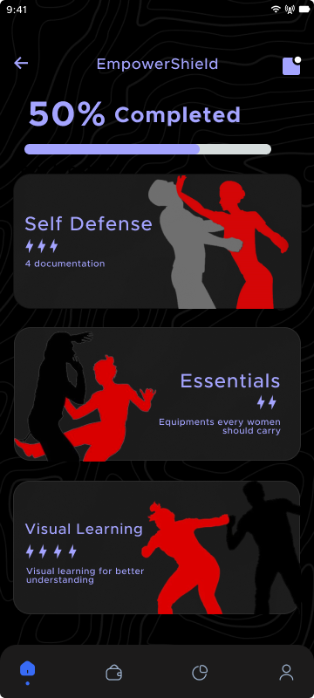
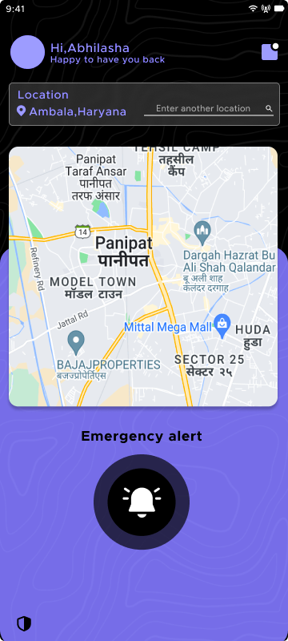
“Your Trusted Wingman for a Safer Tomorrow”
GUARDIAN ANGEL

Slide 2


GUARDIAN
ANGEL
PROBLEM STATEMENT
In our modern society, safety is a top concern, especially for women who may feel uneasy when they're travelling alone. Despite all the technological advancements, there's still a significant issue with getting help quickly when s in trouble. This creates a challenge for women facing bad situations, as they may struggle to reach out for assistance in a timely manner. As a result, there's a pressing need for simpler and faster ways for individuals to ask for help, and for others nearby to recognize when someone is in distress.

Slide 3
GUARDIAN
ANGEL
PROPOSED SOLUTION
GuardianAngel is your ultimate safety companion, offering peace of mind in an uncertain world. With its array of features, it's more than just an app—it's your virtual safeguard. Whether you're navigating dark streets or facing a troubling moment, a simple tap triggers an alert, summoning help swiftly. GuardianAngel's intuitive interface ensures ease of use, empowering you to take charge of your safety effortlessly. From real-time tracking to emergency contacts, it's a comprehensive solution for personal security. In an era where safety is paramount, GuardianAngel stands as a beacon of protection, ensuring you're never alone in times of need.

Slide 4




GUARDIAN
ANGEL
OUR APP SERVICES
Safety Radar: Know your surroundings with a quick check on the Safety Radar. Instantly access the safety status of nearby routes before stepping out.
S.O.S. Beacon: In distress? Tap the S.O.S. Beacon for immediate assistance. Help is just a tap away, ensuring you're never alone in a crisis.
Guardian Angel: Activate real-time tracking with the our feature. Your location is swiftly shared with law enforcement, ensuring a rapid response in emergencies.

Slide 5




GUARDIAN
ANGEL
OUR APP SERVICES
EmpowerShield: Empower women with practical techniques, through visual guides and documentation, ensuring safety and confidence in vulnerable situations.
SimulCall : Ensuring virtual women safety by making a fake call to her after clicking on the button and alerting the threatner as well .
SoundShield : All conversations will be documented from the initial approach of the helper until the seeker reaches her destination.

Slide 6

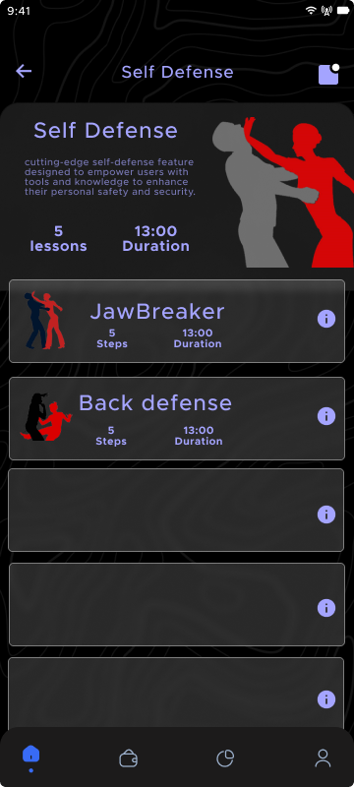
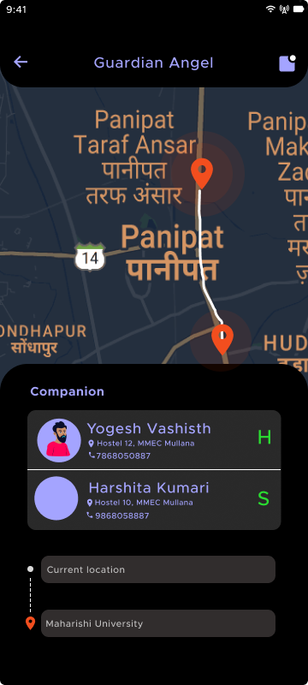
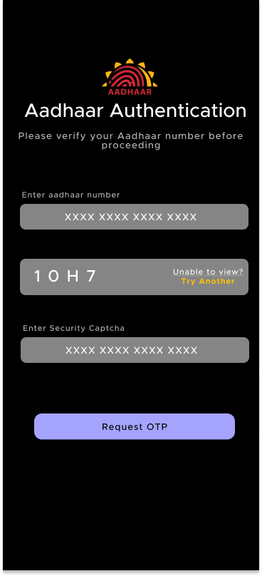
GUARDIAN
ANGEL
OUR APP SERVICES
Angel Reviews : Proper reviews will be given to the person whether he is the seeker or the helper based upon their usage in the past.

Slide 7
GUARDIAN
ANGEL
IMPLEMENTATION STRATEGY
Planning and Scope Definition:
- Define project goals, requirements, and timelines.
Team Formation:
- Assemble a team with expertise in React native, Express js, Appwrite, Figma, Python
Technology Setup:
- Configure React native, Express js, Appwrite, Figma, Python , Node.js , Node.express , Twilio (API) , Render
UI/UX Design:
- Design intuitive interfaces and prototype key screens.
Core Development:
- development of safety app including features as Empowershield, Guardian angel,Angel review etc
API Integration:
- Integrate external APIs for supplementary features.
User Feedback and Iteration:
- Gather feedback and iterate based on user input.
Deployment and Release:
- Prepare and release the app following platform guidelines.
Maintenance:
- Monitor usage and provide regular updates and support.

Slide 8
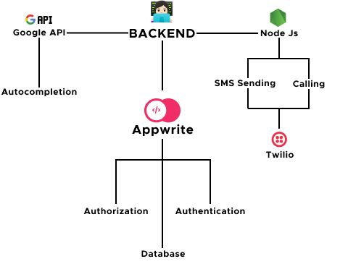
GUARDIAN
ANGEL
FLOWCHART

Slide 9







GUARDIAN
ANGEL
TECHSTACK
Node JS
Firebase
React native
Python
Appwrite
Twilio

Slide 10





OUR TEAM MEMBERS
Yogesh Vashisth
Akshra
Leader
Member
Mr. VISHAL GUPTA
Mentor
Assitant Professor
MMEC, MM(DU)
Harsh Vishwakarma
Urvashi
Member
Member

